Slide 1
Prepare for Migration
Technical Track

Slide 2
Prepare For Migration
Harness the power of ImageRight v. 5 and beyond! This session is for ImageRight system administrators who want more information regarding the new ImageRight architecture. Our discussion will include information about what you should expect as you plan the migration for your organization. The session will focus on the methods and tools available for migration and the differences between them. You will also learn about the tools in 3.x and the v. 5 Readiness Kit that you can use to begin preparing for migration. This information will be helpful in formulating your plans to upgrade to ImageRight v. 5 to meet your business needs.

Slide 3
Chris Murphy
Vertafore – 6 years
Senior Client Consultant
  60+ Implementations
  2+ years dedicated to migrations
  Subject matter expert for all migrations
    Implementation
    Product development
  Manage migration process improvement
Supply chain management software industry
  3 Years
BS Computer Engineering – Georgia Tech

Slide 4
Topics
Overview of general migration process
Migration tools and capabilities
  ImageRight Migration Utility
  ImageRight Conversion Utility (iCon)
  ImageRight Database Split Utility
  Migration Conflict Resolution Module
Preparing 3.x for migration
  3.x system tools
  ImageRight Pre-Migration Analyzer
  Other migration considerations

Slide 5
Session Focus
Previous migration presentations
  Why should we migrate?
  Advantages and enhancements in ImageRight v. 5
This presentation
  Migration options
  Migration specific enhancements
  Beginning 3.x environment preparation

Slide 6
Standard Migration Process
Project Overview

Slide 7
Migration Project Scope
Considerations for starting migration
  Time
  Resources
  Other major projects
Keys to success
  Looking beyond IT
    Business unit involvement
      Communication
      Decision making
      Testing
  Thorough assessment of 3.x system
    3.x System Profile
    No surprises

Slide 8
Standard Migration Project
Three phases
  Pre-migration analysis and project planning
  Model office
  Production migration
Each phase completed before next begins.
Each phase immediately follows previous.
Phase 1
Phase 2
Phase 3

Slide 9
Phase 1
Pre-migration analysis and project planning
Major tasks
  3.x discovery and project plan
  3.x system analysis
  Pre-Migration Analyzer*
  v. 5 hardware
    Production
    Model office
Phase 1
Phase 2
Phase 3
*ImageRight Migration Utility only

Slide 10
Phase 2
Model office
Major tasks
  Full migration in model office
  General system testing
  System administrator training
  User acceptance testing (UAT)
  Production migration finalization
Phase 1
Phase 2
Phase 3

Slide 11
Phase 3
Production migration
Major tasks
  v. 5 Desktop training
  Production migration
  Go Live
Phase 1
Phase 2
Phase 3

Slide 12
Choose Your Path
Comparison of Migration Tools

Slide 13
Different Paths
Migration tools
  ImageRight Migration Utility
  ImageRight Conversion Utility (iCon)
Key differences
  What is migrated?
  What must be setup manually?
Same end result
  Go live in v. 5
  System administrator benefits
  New Desktop functionality

Slide 14
ImageRight Migration Utility
Part of the new architecture suite
Designed specifically for 3.x migrations
Migration in one weekend
Backward compatibility with 3.x integration
  Database imports
  Document imports
  Desktop automation
Pre-migration conflict reporting
Structured and unstructured content

Slide 15
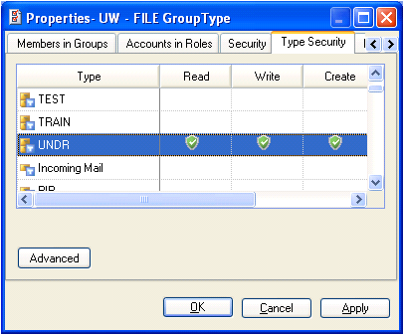
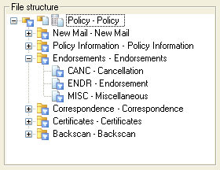
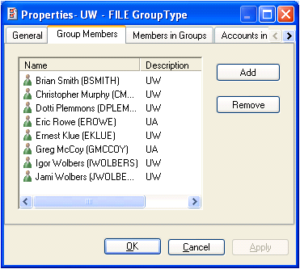
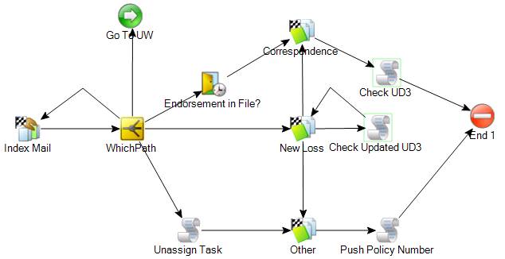
Structured Content
ImageRight framework – rules that your ImageRight system is built upon.
Examples
File structure (organization of drawers, folder types, and document types)
Workflows
Users and groups
Security

Slide 16
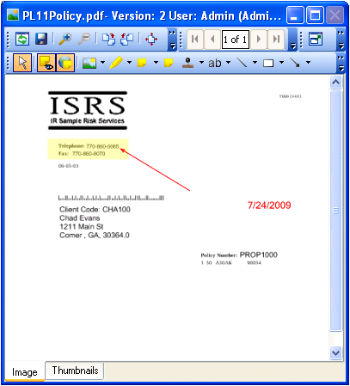
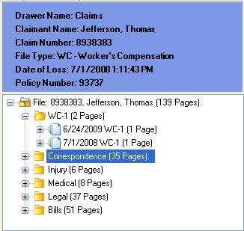
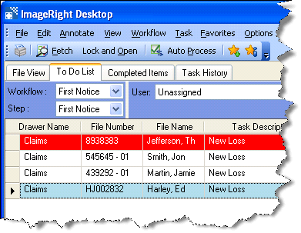
Unstructured Content
Data populating your ImageRight system built upon the rules of the structured content.
Examples
Individual files, folders, documents, and pages
Images (including annotations)
Tasks and history

Slide 17
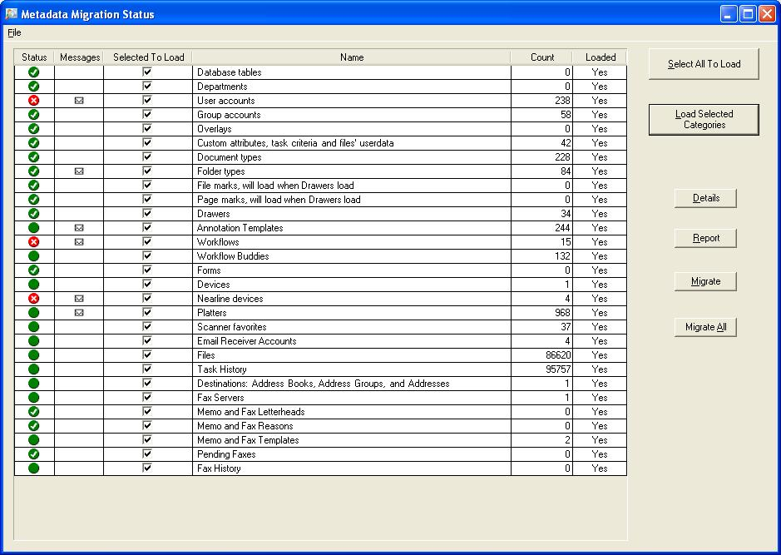
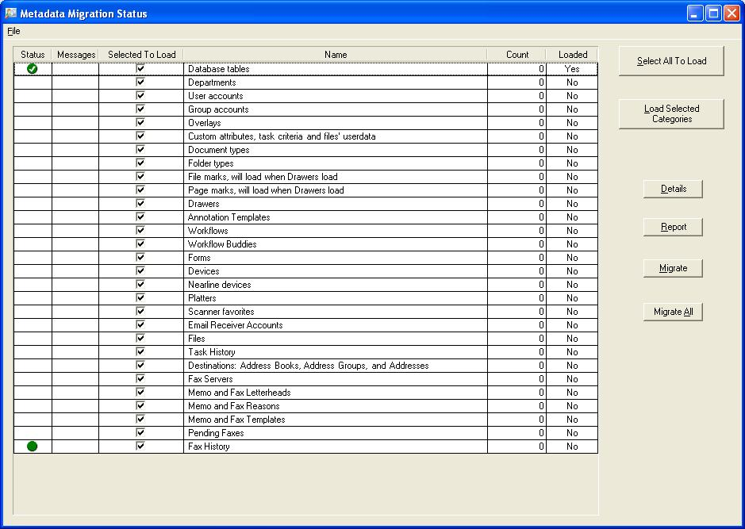
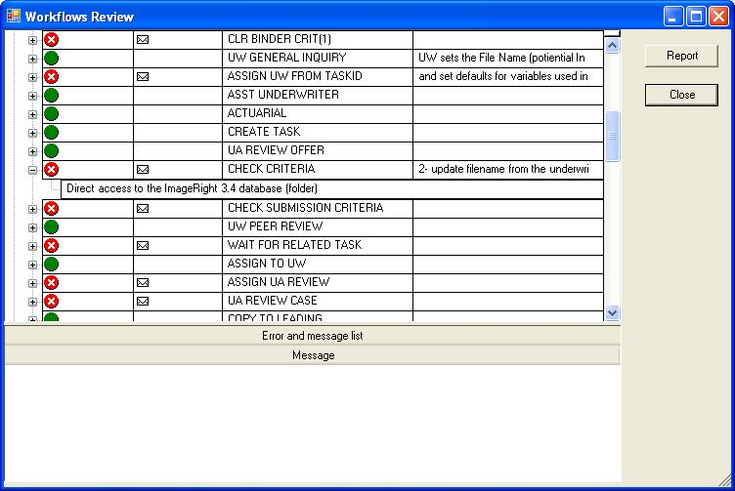

Slide 18
Weekend Migration
Fully functional v. 5 on Monday
  All files and tasks will be available to end user.
    Migrate files on demand
    No performance difference to Desktop user
    Not needed for migrations to date
  Background migration may continue.
    Based on amount of data to migrate from 3.x
    After hours and weekend

Slide 19
Integration
ImageRight Migration Utility supports 3.x formats (through additional v. 5 database tables)
Support for
  Database Imports
    FUP
    AFUP
    AUP
    NUP
    DUP
  Document Imports
    COLD
    HP Print with Embedded Index
  Desktop automation (OCX)*
  Web Services*
*Some functions not implemented or relevant in new architecture

Slide 20
Migration Using iCon
iCon (ImageRight Conversion Utility) – developed by the ImageRight conversion team
Initial purpose – convert content from other imaging systems during ImageRight implementation
Adapted to convert 3.x to v. 5
Unstructured content only

Slide 21
iCon Process
Create v. 5 environment
Recreate structured content
Map 3.x content to v. 5 structures
Run conversion services (multiple machines in parallel)

Slide 22
Flexibility
Make changes to structured content at migration time based on new capabilities
  File structure
    Reorganize
    Consolidate
  Workflows
    Modify
    Combine
  Update security model
    Opportunity to reorganize
    Utilize addition of roles
    Active Directory*
*Converting to AD using Migration Utility must be done in 3.x prior to migration

Slide 24
Considerations
Full migration over weekend not guaranteed
  Amount of data to convert
  Utilize multiple iCon servers in parallel
  Prioritize conversion content
  Convert it now
Image storage requirements (temporary requirement for double storage space)
Migrate from 3.x in phases

Slide 26
What two ImageRight tools are available when migrating to ImageRight v. 5?
ImageRight Migration Utility
iCon

Slide 27
Extending Migration Capabilities
Migration Specific Enhancements

Slide 28
ImageRight Migration Utility
Current options
  All or nothing
  All at once
  Single 3.x to v. 5 environment
  3.x naming conventions remain (for example, 4 letter drawer, document type)
Need for added flexibility
  Migrate by department
  Multiple ImageRight sources

Slide 29
Migration Enhancements
ImageRight 3.x Database Split Utility
  Migrate by department
  “Purge” unwanted data
ImageRight Conflict Resolution Module
  Migrate multiple environments
  Change/consolidate some data types

Slide 30
Why By Department?
Migration is a large, resource intensive project.
It’s more than the physical migration.
Training and go live support are dependent on:
  Number of users/departments.
  Number of support resources.
  Geographical locations
3.x was not implemented in a day.
You asked for it.

Slide 31
How?
iCon
ImageRight Migration Utility
ImageRight 3.x Database Split Utility

Slide 32
3.x Database Split Utility
A new program that splits single 3.x database into 2 separate databases by department.
A department is a set of drawers and dependent workflows used by a business unit within your organization.
Examples
Underwriting or Claims
Personal Lines Underwriting or Claims
Personal Lines Underwriting and Claims
  Two units work together frequently

Slide 33
How does it work?
First some terminology
  Source DB: Current 3.x production DB
  Primary DB: New 3.x production DB after split
  Secondary DB: DB to migrate to v. 5 after split
Production 3.x
New Production 3.x
3.x to Migrate

Slide 34
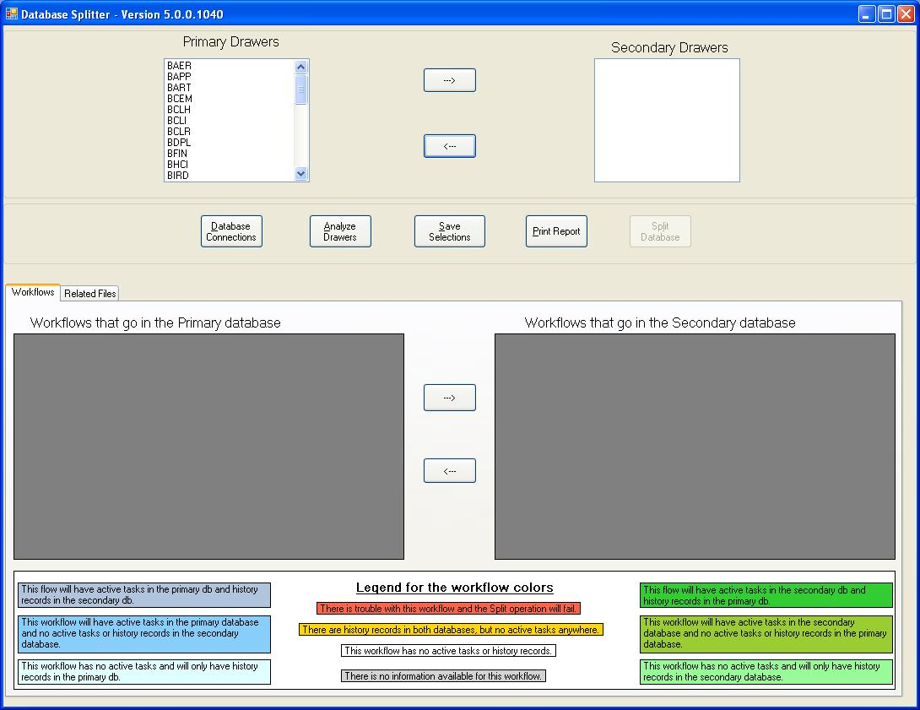
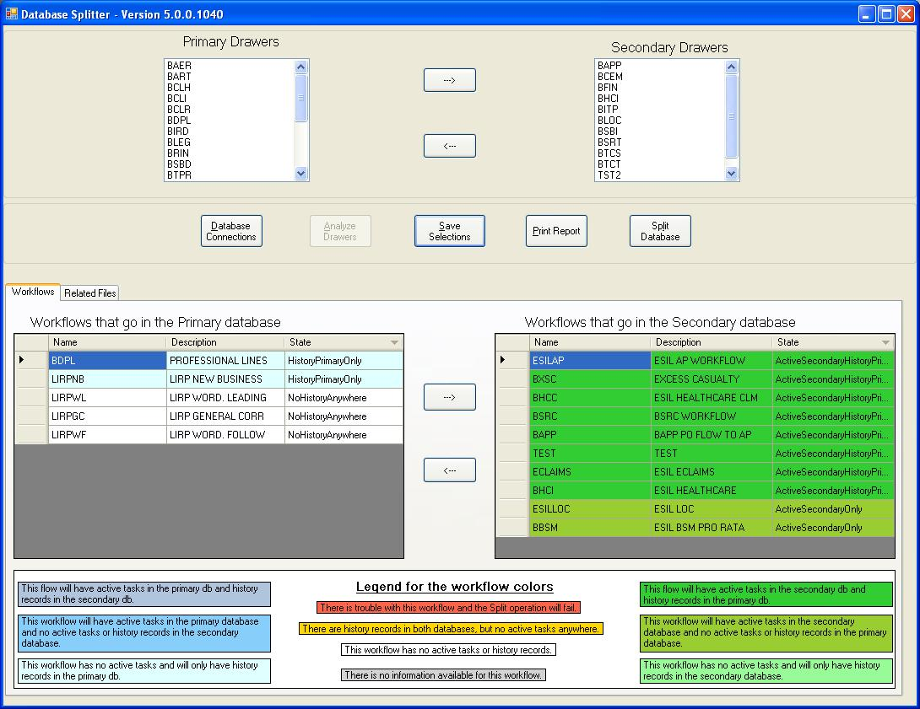

Slide 35
Process
Production 3.x
Production v. 5
Split Utility
Migration Utility
New Production 3.x
3.x to Migrate

Slide 36
Follow on Departments
Production 3.x
Production v. 5
Split Utility
Migration Utility
New Production 3.x
3.x to Migrate

Slide 37
Additional Information
Data can be purged from 3.x.
Secondary database can be migrated immediately. (Not designed for separate 3.x standalone)
ImageRight Split Utility is available late Q3.
Utility is version independent from v. 5.

Slide 38
Conflict Resolution Module
What is it?
  Enhancement to the ImageRight Migration Utility
  Enables migration into existing v. 5 environment
What is it for?
  Standalone 3.x into existing v. 5
  Multiple 3.x into single v. 5

Slide 39
Migration Utility – A History
Original purpose
Fast – migration of a single 3.x system in a single weekend
Recoverable
  Restart and collect errors quickly
  More efficient to overwrite data rather than correct
Not Designed for multiple 3.x sources
  1 to 1 relationship
  Potential damage to existing v. 5 data types for multiple environments

Slide 40
ImageRight Conflict Resolution Module
Adds functionality to address conflicts prior to migration
Options
  Map to existing entity
  Migrate to new entity (take advantage of new capabilities)
  Do not resolve during migration
  Do not migrate conflicting item
When is this available?
  v. 5.2

Slide 41
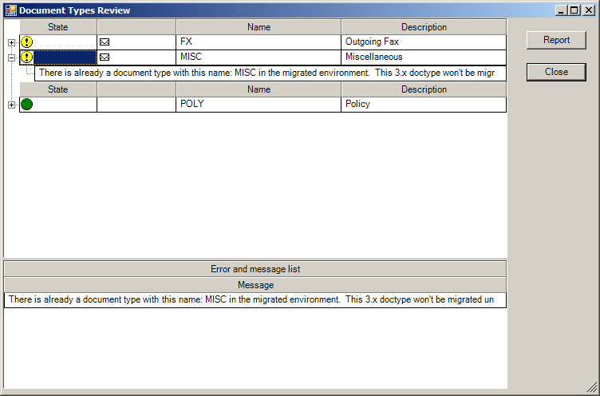
Screen shot

Slide 42
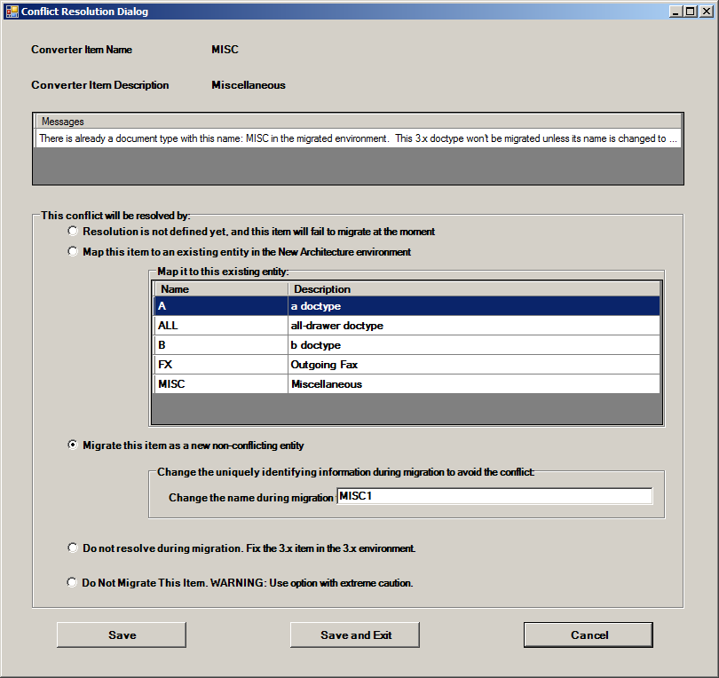

Slide 43
Preparing Your 3.x System
Pre-Migration Tools and Processes

Slide 44
Getting Started
What can you do to prepare for migration now?
What tools are available?
What are the common speed bumps?

Slide 45
Topics
3.x System Tools
ImageRight Pre-Migration Analyzer
Additional considerations
  Workflows
  Integration and reporting
  Active Directory

Slide 46





3.x ImageRight System Tools
Security Manager
System Maintenance
Integrity Check
Advanced Tracer
Workflow Definer

Slide 47
Pre-Migration Analyzer
Available on our Web site through My ImageRight
Identifies items to fix prior to migration
Run during production hours
Runtime based on content of 3.x system (typically 10 – 30 minutes)
Same interface as ImageRight Migration Utility

Slide 48
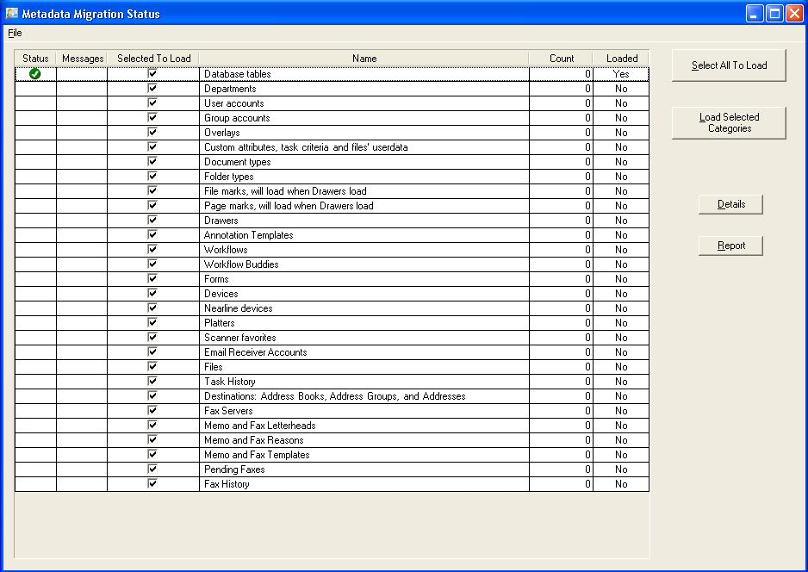
Screen shot

Slide 49
Workflow Considerations
Can be biggest hurdle of a migration
  Most customizable part of the 3.x system
  Test thoroughly during UAT
Examples of items to address
WFCom object
Routing table
Direct queries to ImageRight database
Unsupported Steps
  Print
  Merge task
  Attach form

Slide 50
Other Considerations
Integration
  ImageRight integration is backward compatible.
  Calls to ImageRight
    3rd party system direct calls to ImageRight DB
    Custom reporting
Active Directory
  Difference between 3.x and new architecture
  Switch to Active Directory prior to migration (cannot be done during production migration)

Slide 51
What ImageRight program allows you to migrate by department AND use the ImageRight Migration Utility?
3.x Database Split Utility

Slide 53
Oregon Trail Migration

